Slide 1
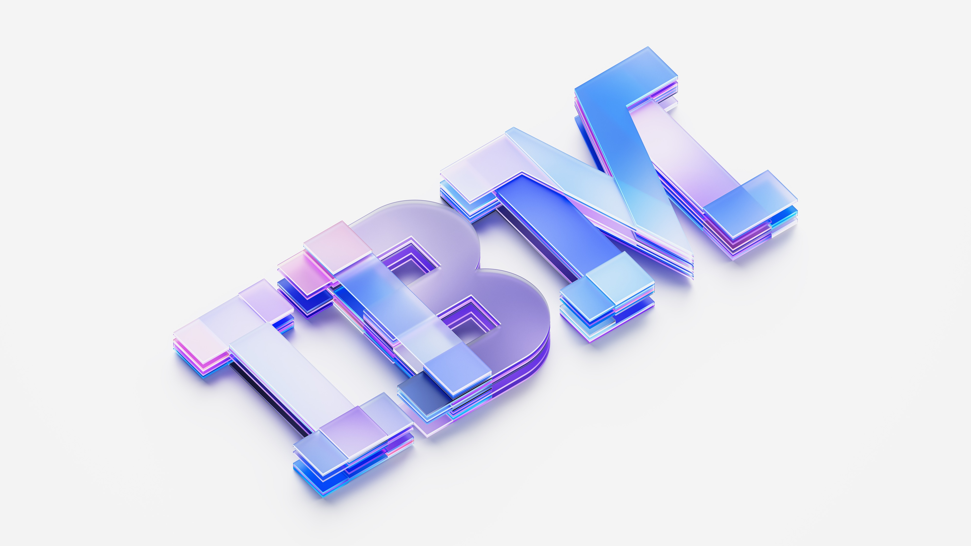

Creating tomorrow solutions, today
Notes:
1

Slide 2
Technology is the engine driving future business growth.
#1
Embedding new technology in the business model is currently the top priority for CEOs looking to drive growth
70%
Of CEOs believe gen AI will significantly change how their company creates, delivers and captures value over the next three years
$5.7TN
Expected global IT spending in 2025, up 9.3% from 2024
Notes:
Technology continues to be the biggest driver and enabler of growth and innovation for companies. It is the most strategic investment that a business or institution can make.
•#1 stat source: "Fortune/Deloitte CEO Survey," Deloitte, 2024
•70% stat source: 27th Annual PWC CEO Survey 2024
•$5.7TN stat source: "Gartner Forecasts Worldwide IT Spending to Grow 9.3% in 2025," Gartner, 2024
2

Slide 3
Realizing this growth relies on your ability
to leverage and build upon your existing technology and teams.
There’s untapped potential in…
Your data
Your applications
Your infrastructure
Your transactions
Your processes
Your security
Your developers
Notes:
Yet the opportunity for growth isn’t only derived from new technology investments. There is a lot of untapped potential in the investments you’ve already made… from better leveraging your data… to improving how you build, manage and run your applications and infrastructure... And more
3

Slide 4






Today’s IBM
Consulting
System integrator partners
Software and SaaS partners
Automation platform
Apptio | Cloudability
Instana • Turbonomic • SevOne • Concert • Target process • Verify • Maximo
Data platform
watsonx
.ai • .data • .gov • Assistants • Guardium
Hybrid Cloud platform
Red Hat
OpenShift • Enterprise Linux • Ansible
Z platform
Public Clouds
Enterprise infrastructure
Edge
Infrastructure
© 2025 IBM Corporation
Notes:
And as you move from +AI to AI+, IBM has the full technology stack and the deep expertise to help you realize the potential of AI deep inside your business, wherever you are on your AI journey.
This is a pivotal moment. Adoption and change management will be imperative to delivering value along with trust, transparency and security.
Now is the time to act. Bring together the right elements and I strongly believe you will be positioned to drive ROI, innovation and lasting competitive advantage—potentially for decades to come.

Slide 5






Data
Access trusted and secure data to drive
AI productivity
AI Productivity
AI/ML Ops
Data Fabric
Data Storage
Reinvent how work is done with AI agents/assistants
Work with AI models, tools and governance that’s built for business—engineered to ensure trust and scalability in applications
Bring all your business data together and optimize how it moves through your systems to scale analytics and AI in your applications while protecting it
Store data across edge, core and clouds
– AI Assistants
– Business Analytics
– Business Automation
– AI Models – AI Tools – AI Governance
– Databases – Data Intelligence – Data Integration – Data Security
– Software-defined Storage
Notes:
The data platform is focused on that shift from +AI to AI+ and propelling the next wave of AI productivity. We do this through enabling productivity across the enterprise through building, deploying, and managing AI assistants and agents at scale. We also unify structured and unstructured data for AI through providing access, management, governance, and security of your data. ​
AI Productivity: Reinvent how work is done with AI agents/assistants. ​
Integrate out of the box or quickly build and deploy custom AI Assistants and Agents with watsonx Orchestrate. Which gives you the freedom to develop and deploy based AI Assistants and agents based on your organization. ​
AI/ML Ops: Work with AI models, tools and governance that’s built for business—engineered to ensure trust and scalability in applications. ​
Streamline the development and deployment ​of AI applications at scale with watsonx.ai. Govern any AI, anywhere, without sacrificing speed and performance​ and automate time consuming audit and documentation processes ​with watsonx.governance. ​
Data Fabric: Bring all your business data together and optimize how it moves through your systems to scale analytics and AI in your applications while protecting it. ​
Access all your data, wherever it resides with watsonx.data. Delivering quality, real-time data across disparate locations, and pipelines with Data Intelligence and Data Integration. ​
Data Storage: Store data across edge, core and clouds​
​
5

Slide 6


































Data
Access trusted and secure data to drive
AI productivity
AI Productivity
AI/ML Ops
Data Fabric
Data Storage
Reinvent how work
is done with AI agents/assistants
Work with AI models, tools and governance that’s built for business—engineered to ensure trust and scalability in applications
Bring all your business data together and optimize how it moves through your systems to scale analytics and AI in your applications while protecting it
Store data across
edge, core and clouds
AI Assistants
AI Models
AI Tools
AI Governance
Databases
Data Intelligence
Data Integration
Data Security
Software-defined Storage
watsonx Code Assistant™
Granite™
watsonx.ai™
watsonx.governance™
watsonx.data™
Data Product Hub
DataStage®
Guardium® Data Security Center
Storage Ceph®
Meta Llama
Databand®
watsonx Orchestrate™
Knowledge Catalog
Mistral
Streamsets
Manta Data Lineage
Planning Analytics & Cognos Analytics + SPSS Modeler
Cloud Pak for Business Automation
Decision Management
Business Workflow & Case
Content Services
Robot Process Automation
Process Mining
Operational Intelligence
Notes:
6

Slide 7

AI Transformation: IBM’s Approach to Shaping Tomorrow
Notes:
The market has reached a point at which expectations of gen AI is at its highest
The energy in the market has now moved towards how to best monetize this technology. It’s time to move from hype to how.
We’re seeing that generative AI investment is surging, with global spend increasing 10x in the last twelve months
It can cut coding time from days to minutes, personalize products down to the tiniest detail, and spot security vulnerabilities almost as soon as they appear. While this jump largely reflects the success of pilots, sandbox experimentation, and other small-scale investments, these early results have business leaders rethinking what’s possible
Reference
(IBV Scaling GenAI Study, 2024)
https://www.ibm.com/thought-leadership/institute-business-value/en-us/report/scale-generative-ai
https://newsroom.ibm.com/2024-01-10-Data-Suggests-Growth-in-Enterprise-Adoption-of-AI-is-Due-to-Widespread-Deployment-by-Early-Adopters
“Gartner Forecasts Worldwide IT Spending to Grow 6.8% in 2024.” Gartner. January 17, 2024. https://www.gartner. com/en/newsroom/press-releases/01-17-2024-gartnerforecasts-worldwide-it-spending-to-grow-six-point-eightpercent-in-2024; “World Economic Outlook. Steady But Slow: Resilience Amid Divergence.” International Monetary Fund. April 16, 2024. https://www.imf.org/en/ Publications/WEO/Issues/2024/04/16/ world-economic-outlook-april-2024
Worldwide IT spending is expected to total $5 trillion in 2024, an increase of 6.8% from 2023, according to the latest forecast by Gartner®”* Gartner Press Release, Gartner Forecasts Worldwide IT Spending to Grow 6.8% in 2024, January 17, 2024. GARTNER is a registered trademark and service mark of Gartner, Inc. and/or its affiliates in the U.S. and internationally and is used herein with permission. All rights reserved.

Slide 8
+AI → AI+
Reinventing how work gets done
Reinventing how work gets done across business domains and industries
© 2025 IBM Corporation
Notes:
AI has gone from a world where companies are thinking about running their business, plus doing some AI to help it (+AI), to a world that is AI first (AI+) to help the business. The leading companies for the next decade or two will be the ones that decide that they will be AI first (AI+). This single decision will dictate how they operate, how they work with employees, and how they work with their customers and suppliers. AI first (AI+), is today’s world.
In short, being an AI first organization means enabling businesses to be value-creators using AI as opposed to solely value users.

Slide 9
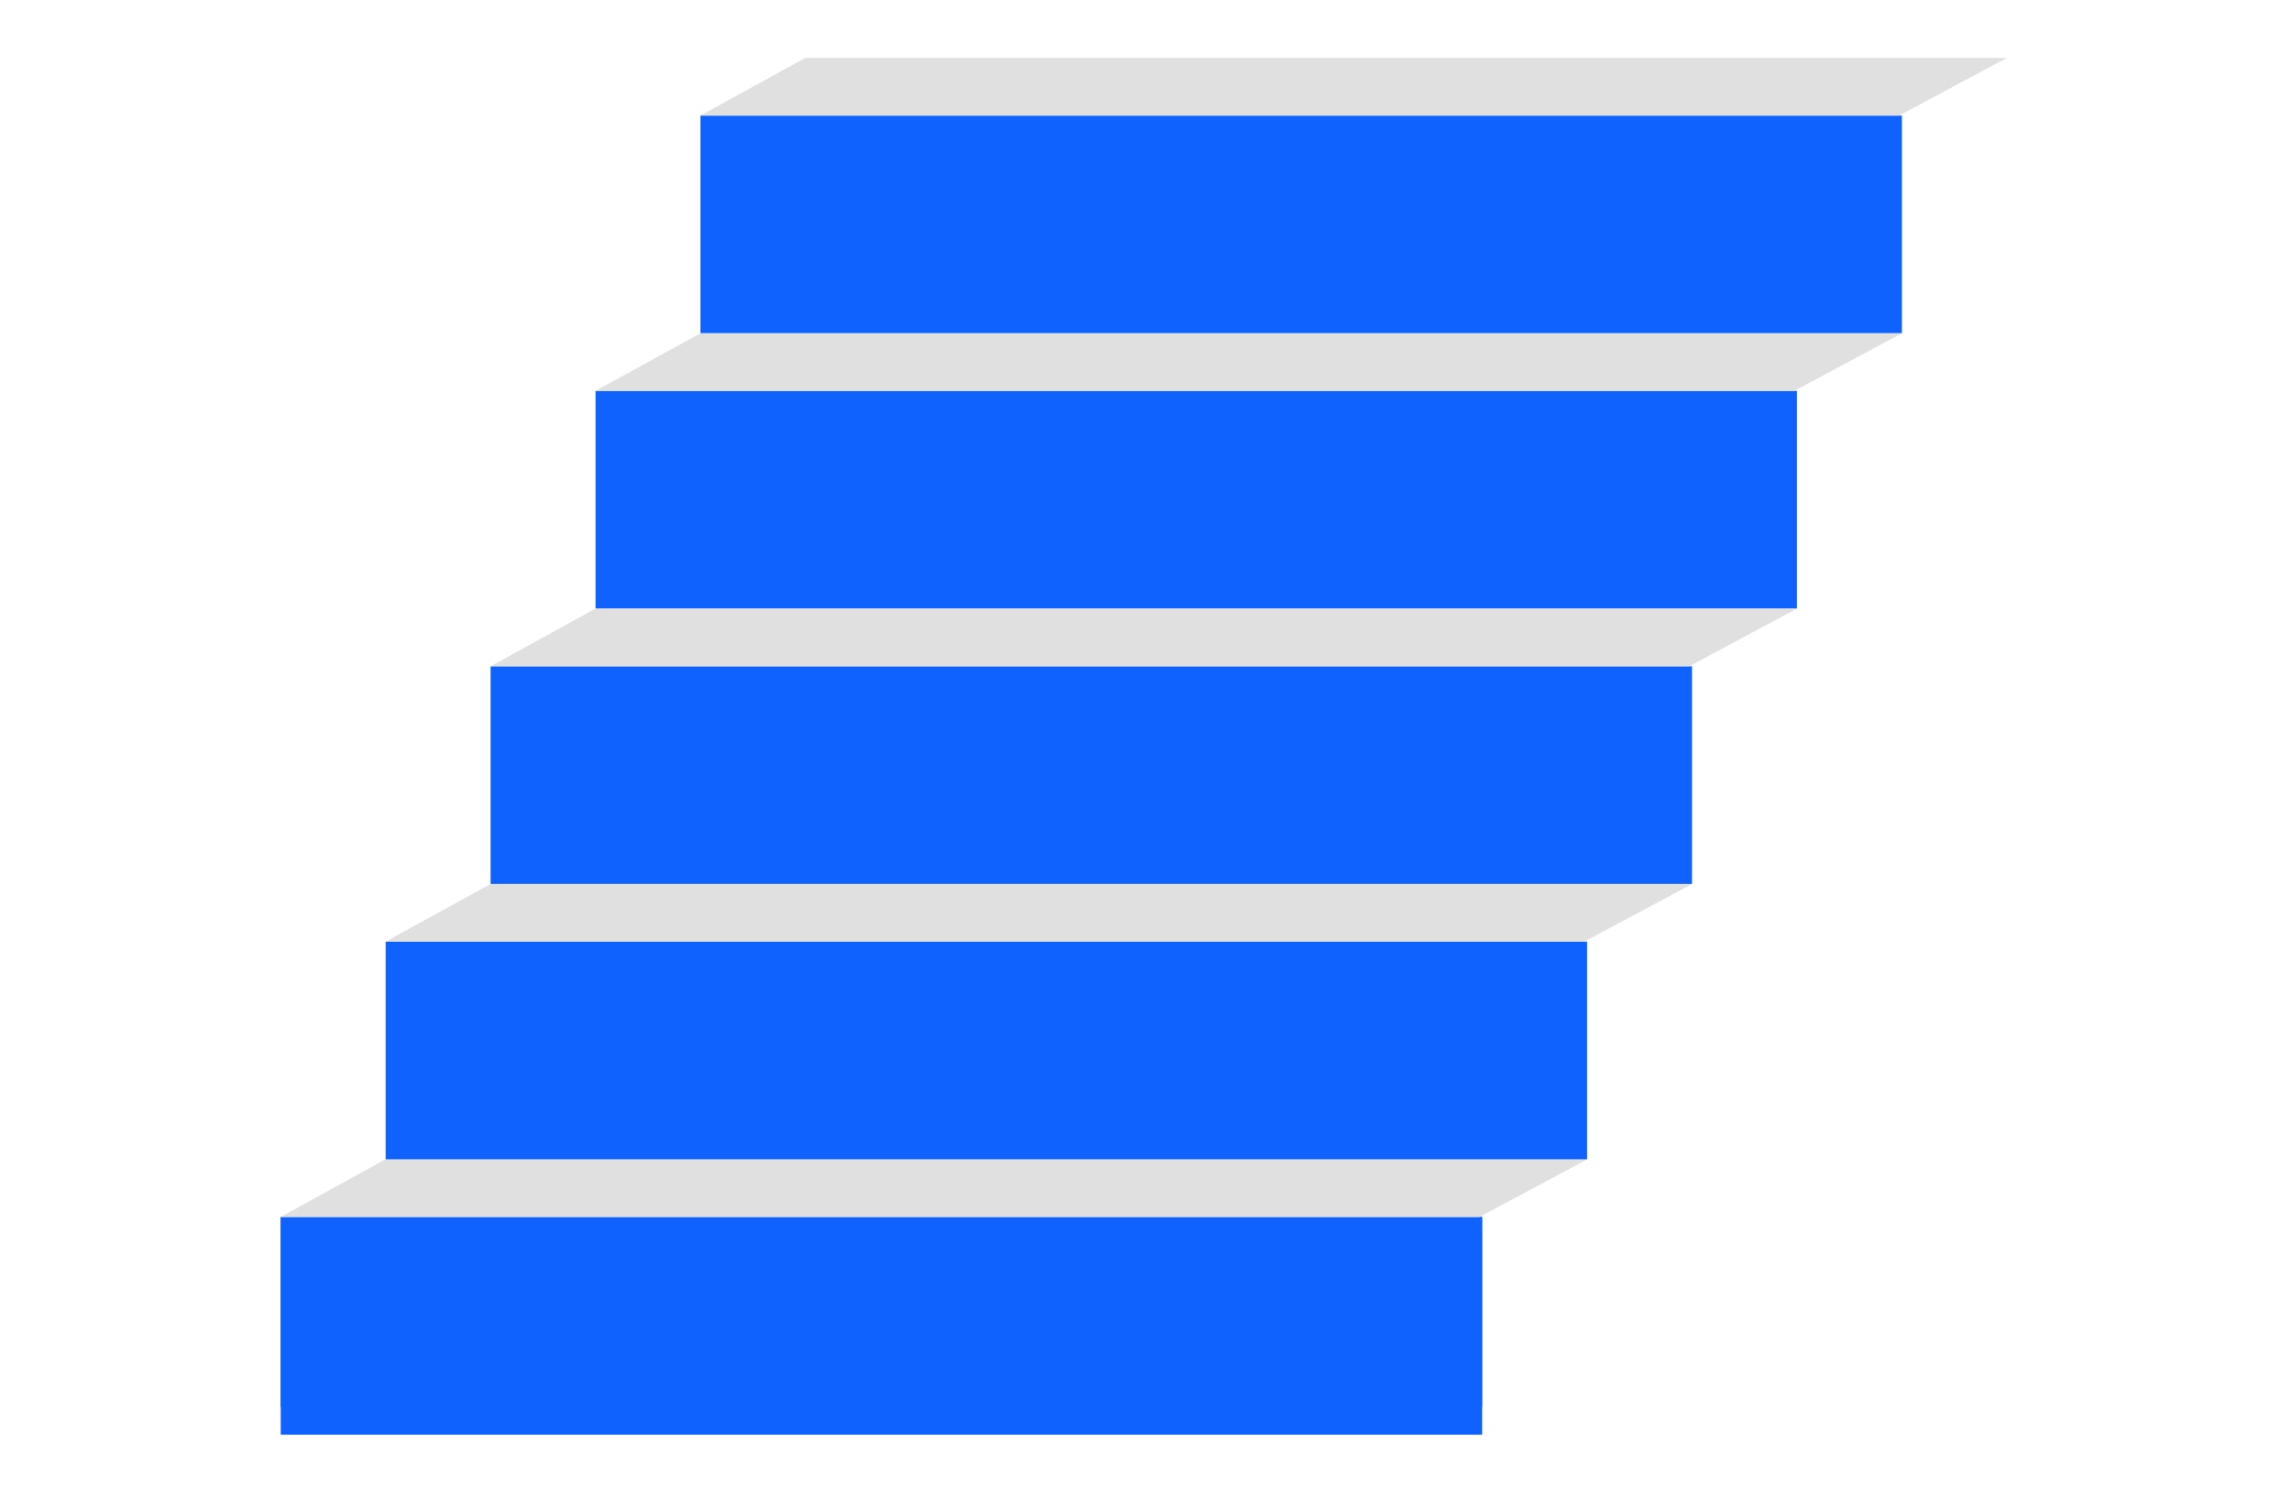





Reinventing how work gets done | +AI to AI+
The modern-day AI ladder
AI does the work
AI+
Replace your workflows
Automate your businesses
Add AI to your applications
+AI
Collect, organize, grow data
© 2025 IBM Corporation
Notes:
This slide image shows a modern-day ladder to artificial intelligence (AI). IBM used this term a few years ago, and it was primarily focused on data and data life cycles with AI at the top rung of the ladder. The “plus AI” (+AI) model is about how clients collect data, organize data, and grow their data. That's the bottom row of the modern-day AI ladder – it all starts with good, collected, and well-organized, trusted data.
Today, this ladder is about how clients add AI to their applications, automate their workflows, replace their workflows, and get to the ultimate point that AI does the work. That is what AI-first (AI+) means.

Slide 10





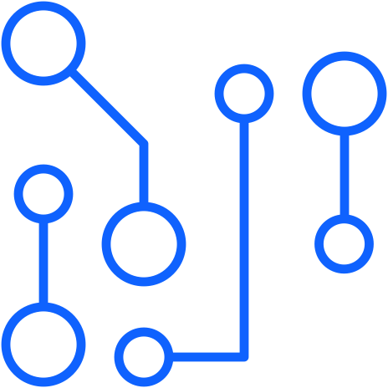

Because the successful deployment of AI is held back by…
Concerns about
AI safety, accuracy, and bias
Siloed data
Skills
Scalability challenges
Lack of application integration
Poor visibility across environments
Notes:
There are a range of reasons why enterprise AI is held back:
Scalability challenges
Lack of application integration
Siloed data
Poor visibility across environments
Concerns about safety, accuracy, and bias
Skills required
10

Slide 11




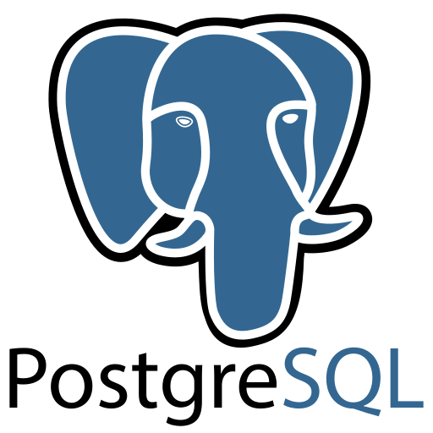
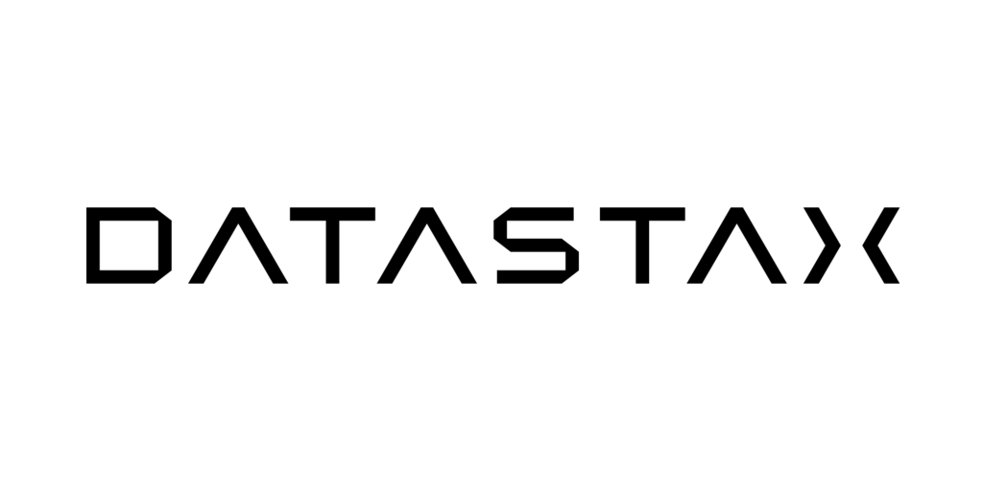
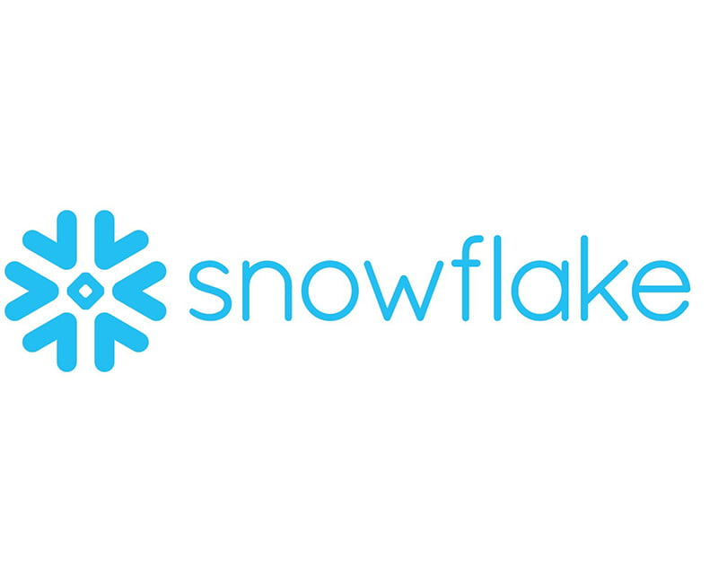



IBM Cloud Pak for Data
Investments in an open and trusted data foundation will accelerate and scale your AI initiatives
Databases
Data Fabric
watsonx™
Scale and accelerate the impact of AI with trusted data
AI and Data Platform
watsonx.ai
watsonx.data
watsonx.governance
AI Assistants
watsonx Orchestrate
watsonx Assistant
watsonx Code Assistant
Store, unify, and share data with open formats and native integrations
Simplify data access across the enterprise and hybrid cloud environments with a data fabric architecture
Database
IBM Db2
IBM Informix
Data Governance
IBM Knowledge Catalog
Manta
Data Integration
IBM DataStage
IBM Data Replication
IBM Data Virtualization
Data
Delivering quality data to consumers and users
Data Warehouse
IBM Db2 Warehouse
IBM Netezza
Data as a Product
Delivering data products
Data Lakehouse
IBM watsonx.data
AI
Enabling data teams to be more productive with automated insights
Data Observability
IBM Databand
Master Data Management
IBM Master Data Management
3rd party databases
Any many more
IBM Cloud Pak for Business Automation
Business Automation Workflow | Decision Management | RPA | FileNet | Datacap
© 2025 IBM Corporation
Notes:
As we know, it is also critical to deliver trusted data because AI is only as good as the data that fuels it.
This dependency on data for successful implementations of AI, underscore the importance of the CDO’s role in AI.
IBM enables clients to simplify access and consumption of data for AI workflows by leveraging an open and trusted data foundation
We provide native integrations across our databases portfolio and support open formats such as Iceberg, enabling the ability to store, unify, and share data for analytics and AI without additional ETL or duplication of data. For example, Amazon RDS for Db2 natively integrates with Db2 Warehouse and watsonx.data lakehouse on AWS to prepare transactional data for analytics and AI. Cloudera, Snowflake, Amazon Redshift, and any 3rd party analytics engine that supports Iceberg can now unify data and optimize workloads with multiple query engines in watsonx.data.
But that’s not enough. Customers have databases from a lot of different sources and fit for purpose databases across every database type. For that, you need a data fabric. With a data fabric architecture, clients can automate discovery and enrichment of data with our centralized data governance capabilities, enable data observability across various pipelines, employ various data integration styles, and management of data quality to deliver reliable data for AI workflows
This feeds watsonx itself, where all of your AI workloads can be executed with trusted and high quality data.
With the IBM data fabric architecture, clients leverage a unified platform that makes all data—spanning hybrid and multicloud environments—available for AI workflows; this composable and modular architecture provides the flexibility for clients to utilize the pertinent capabilities they need, while maximizing their existing infrastructure.

Slide 12

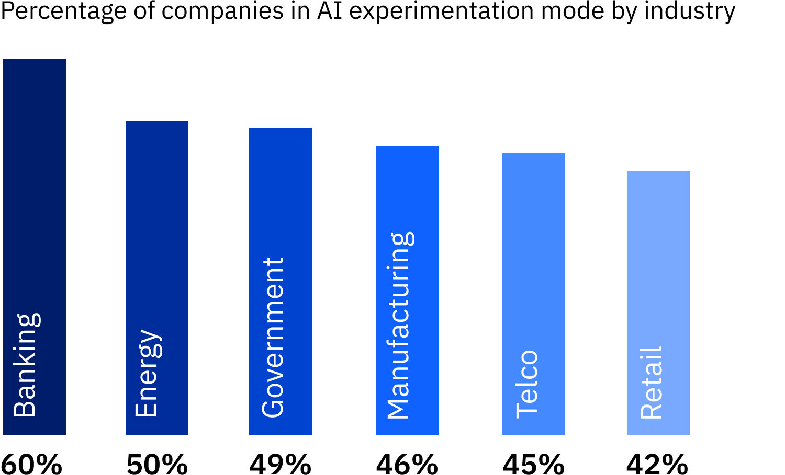
AI can be the key that turns your tech into your competitive edge
Yet the biggest question companies are trying to answer is how to drive value
$4.4T
Potential value added by gen AI to global corporate profits annually
72%
of CEOs say their competitive advantage depends on gen AI
Only 23% of businesses report that AI has significantly contributed to their EBIT.
Sources: “Beyond the hype: Capturing the potential of AI and gen AI in tech, media, and telecom,” McKinsey, 2024;
“6 hard truths CEOs must face,” IBV, 2024; IBM Global AI Adoption Index, IBM, 2024; The state of AI, McKinsey, 2023
Notes:
Now, gen AI has accelerated what’s possible. It will be the key to transforming how we work and operate on multiple dimensions.
In fact, gen AI will disrupt and reconstruct every application and process that are running the enterprise. And it cannot do that without leveraging existing investments.
It’s a core reason why many are finding it hard to achieve real business value with AI.
12

Slide 13

And today, less than 1% of enterprise data is currently being leveraged by gen AI
Notes:
So, many businesses have started by applying AI to the fringes of their operations
Only 31% of executives say their organization uses AI in more than one function (Source: The state of AI, McKinsey, 2023.)
Under 1% of enterprise data is used by generative AI (Source: The Future of AI is Open, IBM, 2024.)
This is why the first wave of AI experimentation has shown how elusive it is to achieve measurable business results.
13

Slide 14
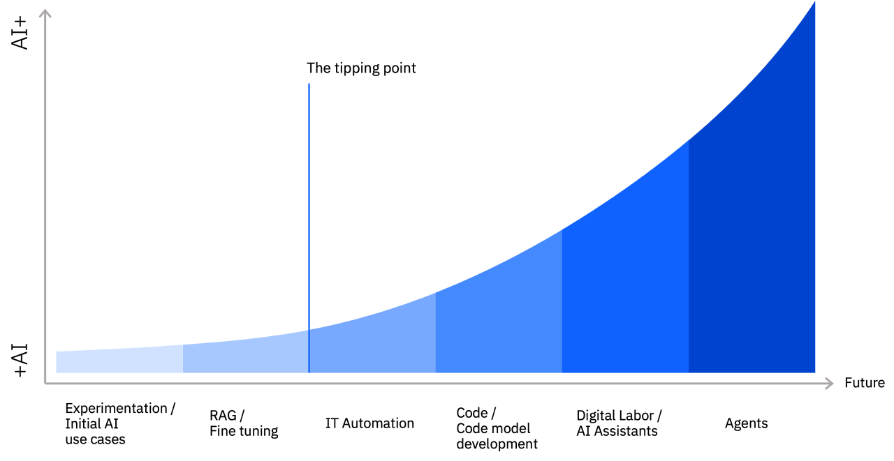
To truly realize the benefits of AI, you need to accelerate its adoption, leveraging your unique data in moving from +AI to AI+
The AI value creation curve
Notes:
To achieve real value, you must shift your mindset from +AI to AI+… and do a lot more than adding AI to existing work or processes.
Right now, companies are trying to move from +AI to AI+.
+AI means that a company is simply adding AI to their existing work or processes. AI+ means ‘AI first’, in that a company is reinventing itself around the opportunity in AI.
The journey to AI+ is similar for many: it starts with experimentation and a few initial use cases. With growing sophistication you can use RAG and fine tuning to get better models.
The tipping point comes when you combine it with IT Automation inside the enterprise. From there, as you apply AI to code and digital labor, and incorporate AI assistants and agents into your processes, it really gets woven into the fabric of the company. This is "AI+”
Yet, even as AI adoption has increased dramatically over the last few years, Gartner reports that as many as 54% of AI projects fail to move past pilot and into production due to obstacles such as complexity, cost and risk
I would start to ask yourselves, what are you doing to start to ride the wave of value creation in AI, we think this moment is upon us
14

Slide 15
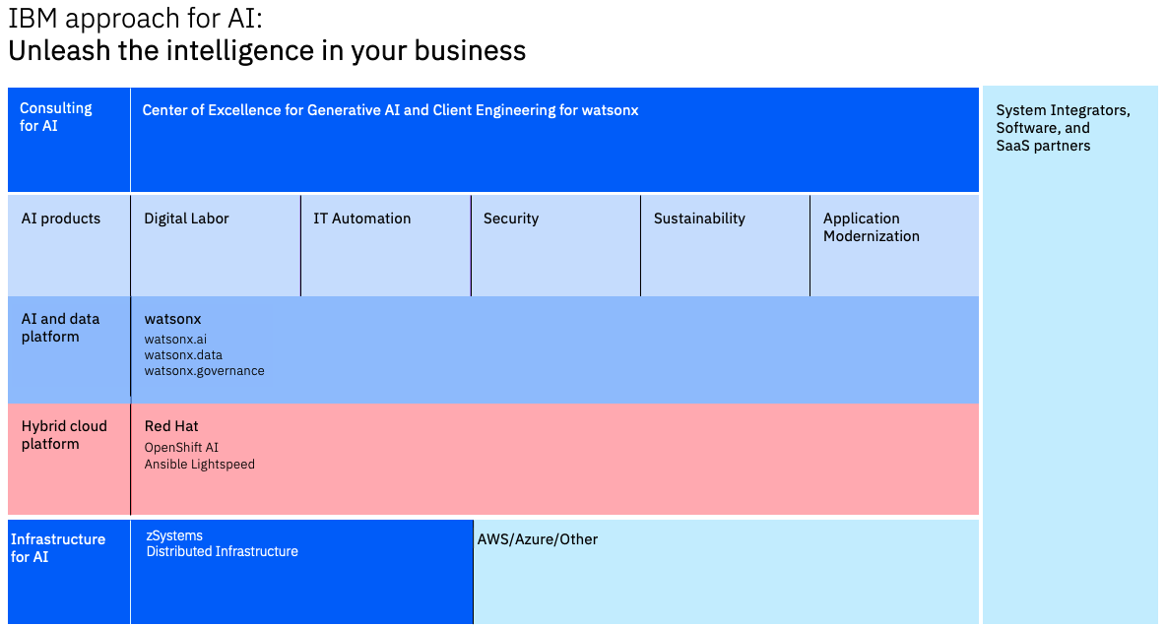
Boxes (4 tall)
IBM is investing heavily in AI, moving towards an AI first approach
+AI → AI+
Digital Labor is IBM’s strategy for AI+ Business Automation
Notes:
IBM is heavily investing in AI, much of this with watsonx.ai, watsonx.data, and watsonx.governance
IBM's vision is to progress to an AI first approach, where AI does the work for you.
A key element of this vision is digital labor including Cloud Pak for BA, our intelligent automation suite, and watsonx Orchestrate and, a conversational interface with the capabilities to dynamically orchestrate workflows based on a wide range of automation skills.

Slide 16
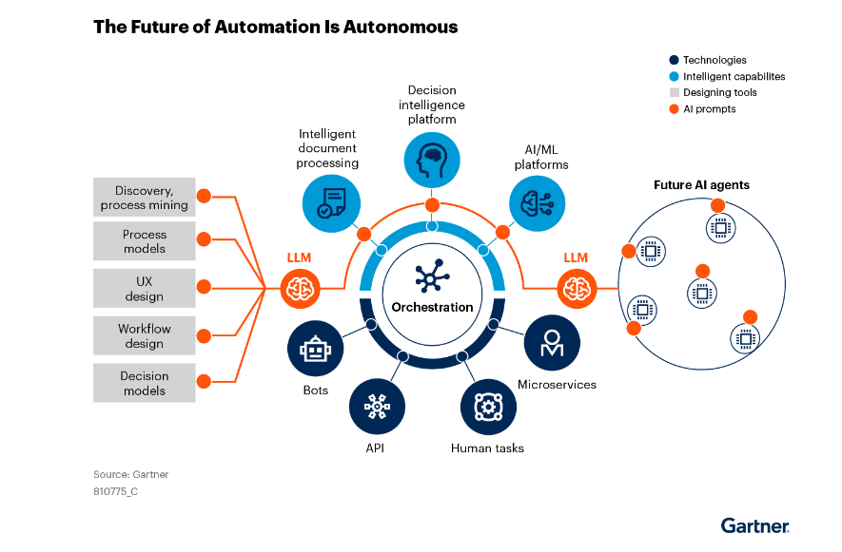
Boxes (4 tall)
+AI → AI+
The Future of AI + Business Automation is Autonomous
IBM provides the most comprehensive interconnected AI-powered automation platform on the market
Customers are asking for next-Gen, modular, platforms leveraging AI Agents to automate Tasks, Decisions, and E2E business processes to drive productivity, resiliency, and adherence to regulatory compliance
Future of BA & WxO = Digital Labor Platform
Notes:
IBM is heavily investing in AI, much of this with watsonx.ai, watsonx.data, and watsonx.governance
IBM's vision is to progress to an AI first approach, where AI does the work for you.
A key element of this vision is digital labor including Cloud Pak for BA, our intelligent automation suite, and watsonx Orchestrate and, a conversational interface with the capabilities to dynamically orchestrate workflows based on a wide range of automation skills.

